Slide 1
Corporate Overview
BIO 2017

Slide 2
Huntington’s Disease
Progressive motor and cognitive function loss with rate and severity predicted by >35 CAG repeats (encoding glutamine)
N-terminal fragment (nHTT) of huntingtin protein
Gene Dysregulation a presymptomatic condition in human patients (up to 15 years)
nHtt binds to nucleic acids in polyQ dependent manner
Soluble N-terminal Htt Perinuclear Aggregate
Perinuclear aggregate destabilizes nuclear membrane & contributes to neuron loss

Slide 3
Intrabodies (intracellularly acting antibody fragments)
Initial cytoplasmic soluble framework
Platform for selection of soluble active binders in cytoplasmic environment
Initial collaboration on Huntington’s Disease with Caltech (Late Paul Patterson)
Selected family of binders to proline rich sequence with rAAV-INT41as the lead

Slide 4
INT41 Female R6/2 Animals Exhibit Normal Cognitive Function (9-10 weeks)**
Acquisition (Male )
Acquisition ( Female )
R6/2_Wt VEH n=4
R6/2_Wt VEH n=9
8
R6/2_Tg GFP n=5
7
R6/2_Tg INT41 n=6
R6/2_Tg GFP n=6
7
6
R6/2_Tg INT41 n=8
5
6
*
5
Average days to reach criteria
4
*
4
3
3
2
2
1
1
0
0
Genotype
-
Genotype
Treatment
-
Treatment
** J Neurodeg. Dis. 2016, http://dx.doi.org/10.1155/2016/7120753
* INT41 treated females are not statistically different from normal controls using Statview 2 way Anova & Kaplan-Meier analysis (all animal work done by Psychogenics)

Slide 5
HTT Gene Dysregulation
INT41 corrects 50% over or under expression of hundreds of genes altered (-2.4 to 6X) by Htt (Q103)
Same key genes affected in animal models and human patients
Filtered from 84 genes p<0.001
33% Transcription/translation (ETV5, CREB, ID3*)
21% Kinases (AKT1 (1.90X vs 1.06X), MAP2K4, IKBKB)
12% Heat shock (HSP90, HSP70, HSP40 (DNAJ))
9% Mitochondrial (COX7A2, CYC1, SCL25A2)
Apoptosis, p38/jnk via GADD45A, PCNA

Slide 6
Model for Htt Pathogenesis
Proteases
(Caspases)
Aggregates
Proteosome degradation
N-terminal Toxic fragments contain
polyQ & Proline rich region
Htt
Nuclear Pore
Nuclear aggregate*
Gene
Dysregulation
Nuclear Chromatin & RNAs
*RNA likely also binding

Slide 7
INT41 Modifies Disease
Aggregates
Proteases
u
u
= INT41
Proteosome degradation
u
u
u
u
Htt
INT41 reduces nuclear transport of
N-terminal Toxic fragments
Nuclear
compartment
Nuclear Aggregates
u
u
Gene
Dysregulation
(reduced binding of nHTT)
Nuclear Chromatin & RNAs

Slide 8
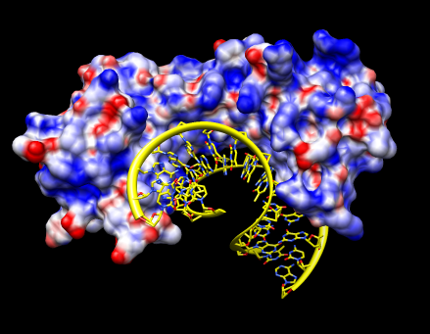
PolyQ Dependent Binding to DNA
INT41 stabilizes structure & inhibits
aggregation onto DNA
N-
polyQ
proline rich
INT41
Relationships driving disease
(Q)n> Increased DNA Binding> Gene Dysregulation> Onset age

Slide 9
Key Takeaways
No toxicity (histology) observed in R6/2 model
Others have similar observations in animal models
INT41 reduces binding of N-terminal Htt (Q73) to DNA to normal (Q23) levels
Inhibits aggregate formation
Increases rate of nHtt degradation
No off target effects (RNA arrays)
INT41 turned over in cell with no accumulation
INT41 does not bind to full length Htt protein
INT41 stabilizes fragment structure or conformation fragment turnover

Slide 10
INT41 to Clinic
$3M IND enabling package
Finalize animal model studies capturing IND enabling data (AAV1)
cGMP Manufacturing rAAV1-INT41
Toxicology 12 nonhuman primates at 2 doses
$12M Pivotal human trial
Phase I/II POC clinical trial
40-60 patient safety trial with multimodal Neuroimaging (caudate atrophy) and UHDRS

Slide 11
CONTACTS Lee Henderson, CEO Vybion, Inc. PO Box 4030 Ithaca, NY 14852 Mobile: 607-227-2502 lhenderson@vybion.com www.vybion.com
Thank You

